Slide 1

Intro to Neural Networks
June 23, 2020

Slide 2
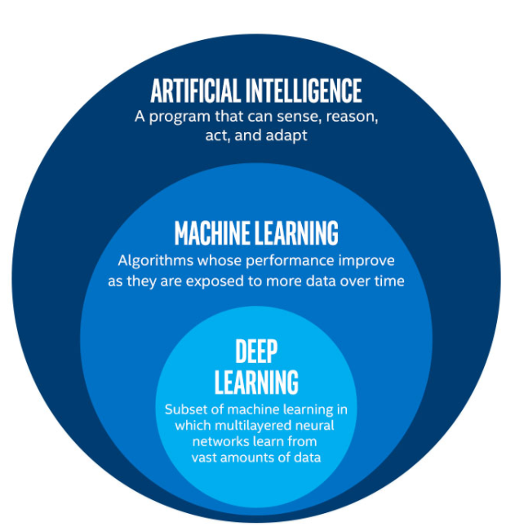

Slide 3
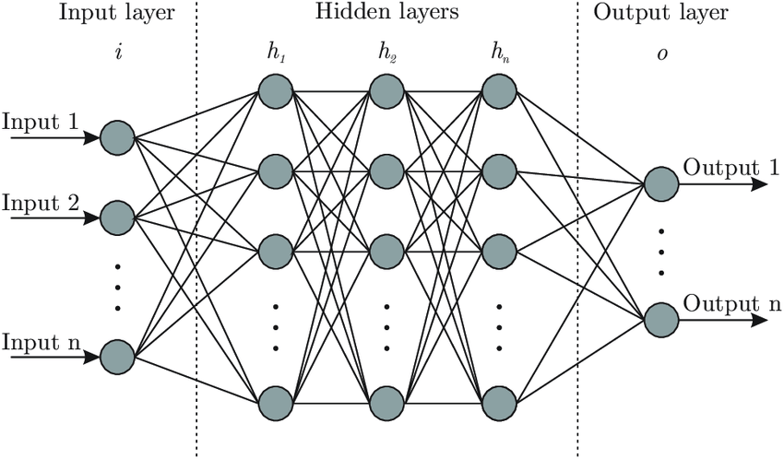
Deep Neural Network

Slide 4
Example Video

Slide 5
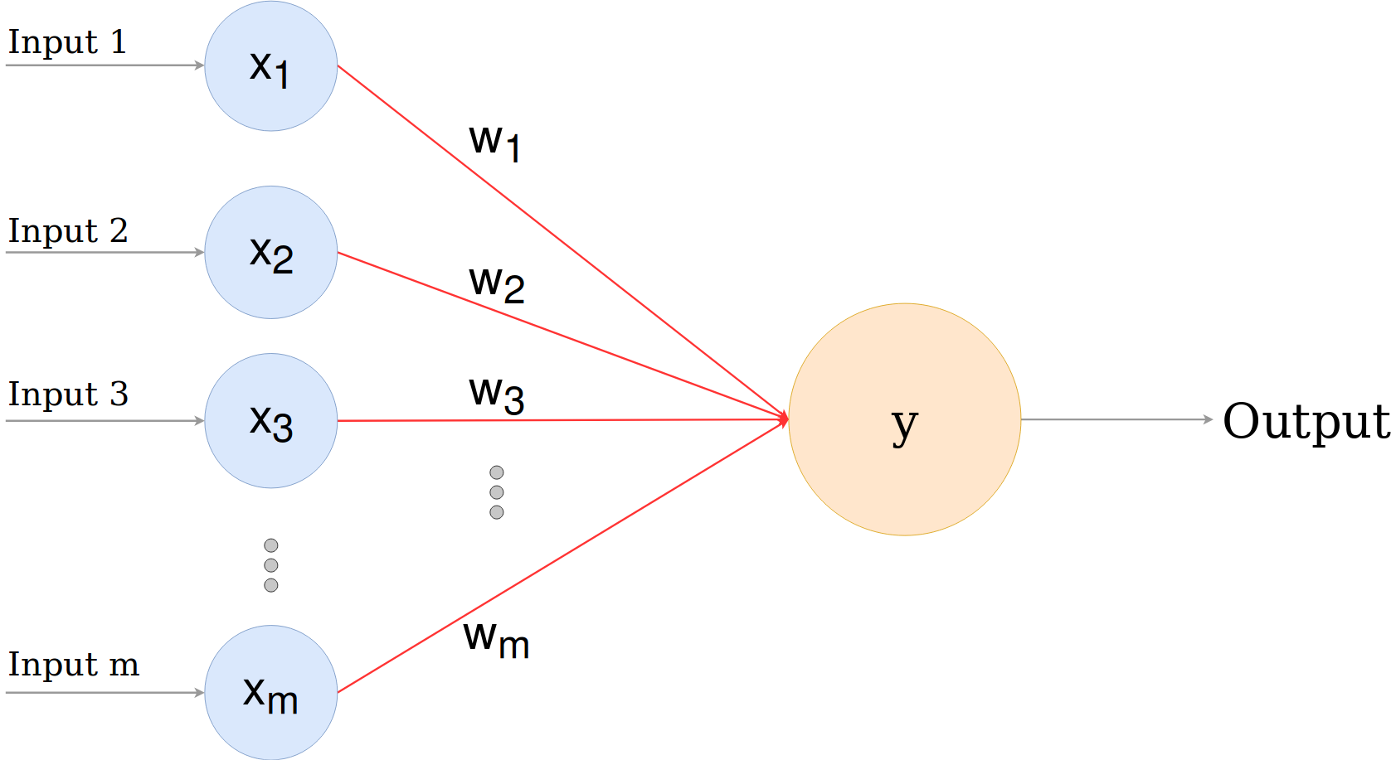
Perceptron

Slide 6
What skills are needed to create NN?
Calculous
Linear Algebra
Advanced Programming
Matrix manipulation
List comprehensions
Assert keyword
List / object memory allocation
Function default parameters

